Slide 1
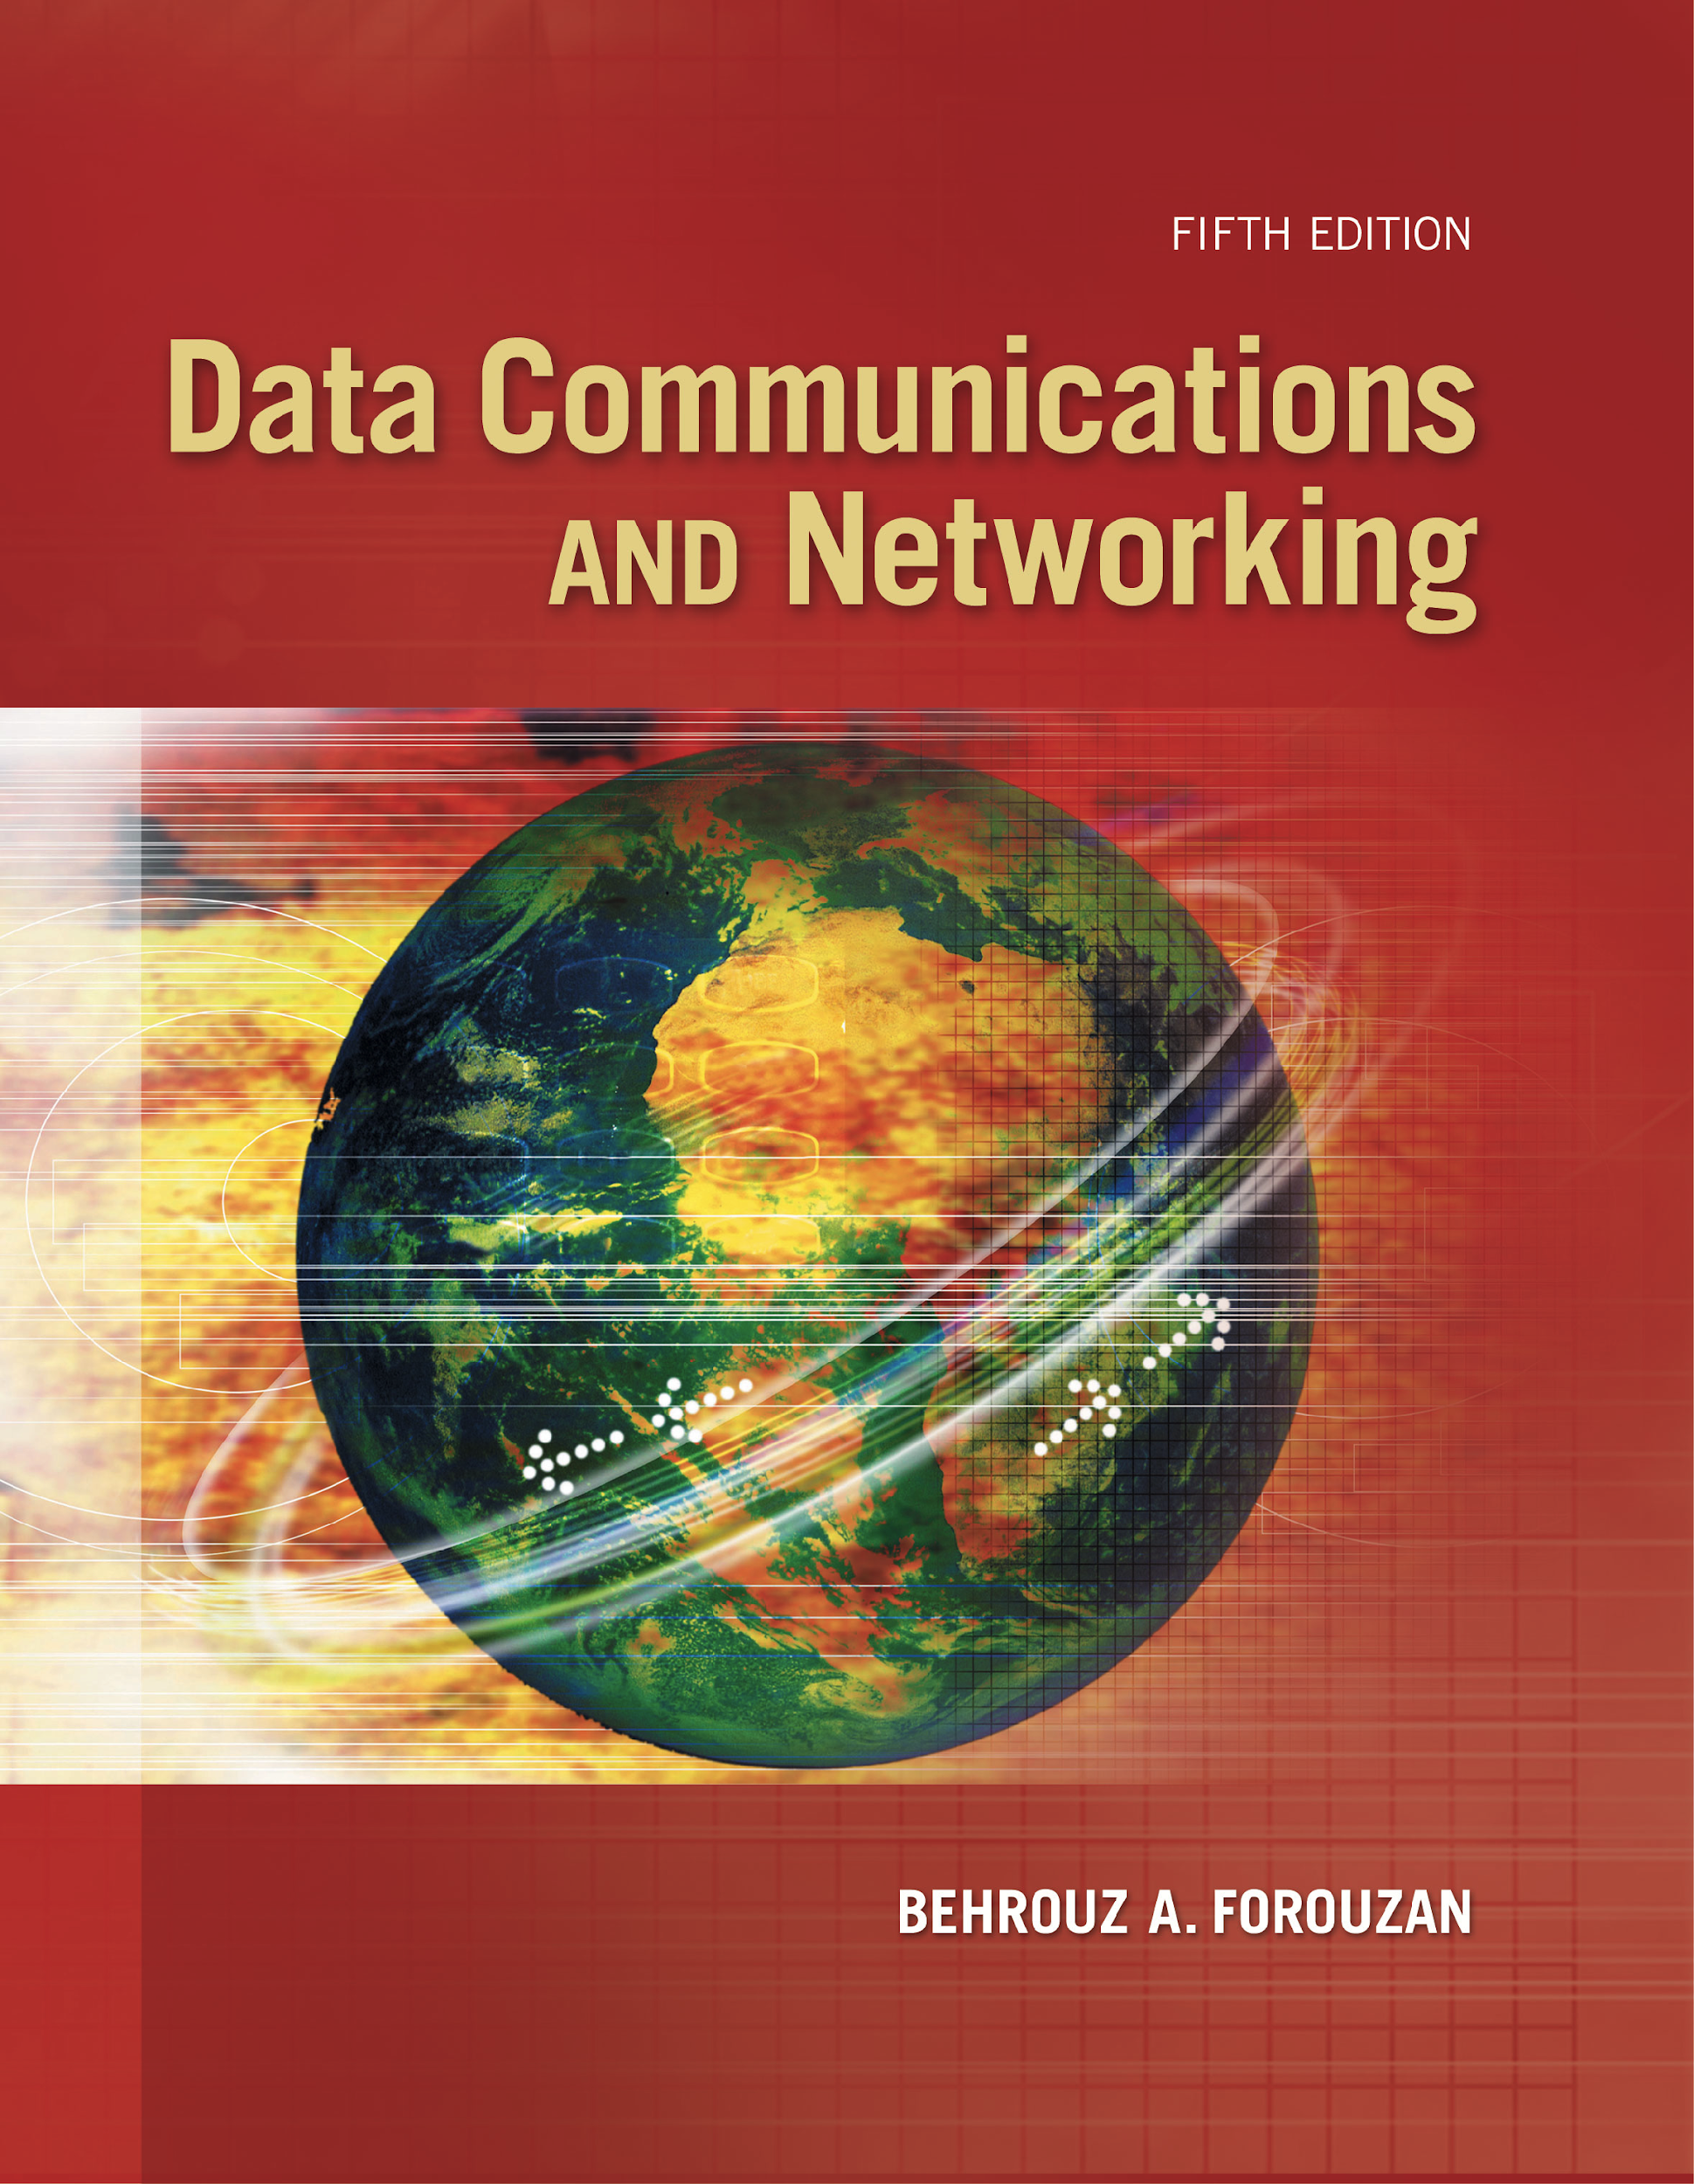
Chapter 13
Wired LANs:
Ethernet
Copyright © The McGraw-Hill Companies, Inc. Permission required for reproduction or display.
Notes:
1

Slide 2
Chapter 5: Outline
13.1 ETHERNET PROTOCOL
13.2 STANDARD ETHERNET
13.3 FAST ETHERNET
13.4 GIGABIT ETHERNET
13.5 10 GIGABIT ETHERNET
Notes:
13.#

Slide 3

Chapter 13: Objective
The first section discusses the Ethernet protocol in general. It explains that IEEE Project 802 defines the LLC and MAC sub-layers for all LANs including Ethernet. The section also lists the four generations of Ethernet.
The second section discusses the Standard Ethernet. The section first describes some characteristics of the Standard Ethernet. It then discusses the addressing mechanism, which is the same in all Ethernet generations. The section next discusses the access method, CSMA/ CD, which we discussed in Chapter 12. The section then reviews the efficiency of the Standard Ethernet. It then shows the encoding and the implementation of this generation.
Notes:
13.#

Slide 4
Chapter 13: Objective (continued)
The third section describes the Fast Ethernet, the second generation, which can still be seen in many places. The section first describes the changes in the MAC sublayer. The section then discusses the physical layer and the implementation of this generation.
The fourth section discusses the Gigabit Ethernet, with the rate of 1 gigabit per second. The section first describes the MAC sublayer. It then moves to the physical layer and implementation.
The fifth section touches on the 10 Gigabit Ethernet. This is a new technology that can be used both for a backbone LAN or as a MAN (metropolitan area network).
Notes:
13.#

Slide 5
13-1 ETHERNET PROTOCOL
The data-link layer and the physical layer are the territory of the local and wide area networks. This means that when we discuss these two layers, we are talking about networks that are using them. As we see in this and the following two chapters, we can have wired or wireless networks. We discuss wired networks in this chapter and the next.
13.5
Notes:
13.#

Slide 6
13.13.1 IEEE Project 802
In 1985, the Computer Society of the IEEE started a project, called Project 802, to set standards to enable intercommunication among equipment from a variety of manufacturers. Project 802 does not seek to replace any part of the OSI model or TCP/IP protocol suite. Instead, it is a way of specifying functions of the physical layer and the data-link layer of major LAN protocols. The relationship of the 802 Standard to the TCP/IP protocol suite is shown in Figure 13.13.
13.6
Notes:
13.#

Slide 7
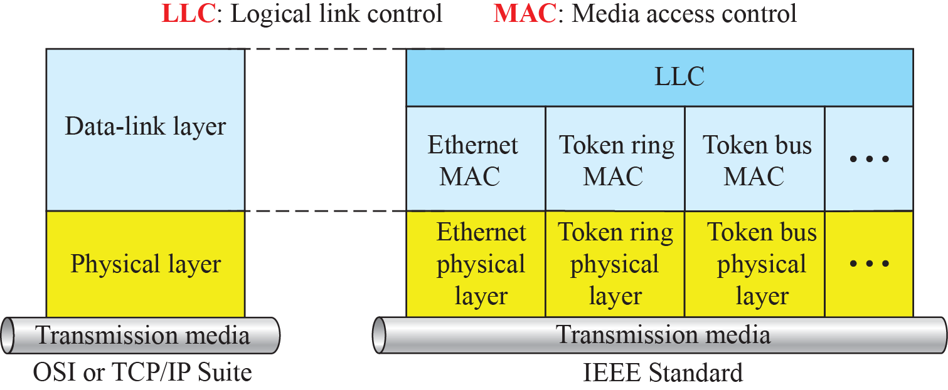
Figure 13.1: IEEE standard for LANs
13.7
Notes:
13.#

Slide 8
13.13.2 Ethernet Evolution
The Ethernet LAN was developed in the 1970s by Robert Metcalfe and David Boggs. Since then, it has gone through four generations: Standard Ethernet (10 Mbps), Fast Ethernet (100 Mbps), Gigabit Ethernet (1 Gbps), and 10 Gigabit Ethernet (10 Gbps), as shown in Figure 13.2. We briefly discuss all these generations.
13.8
Notes:
13.#

Slide 9
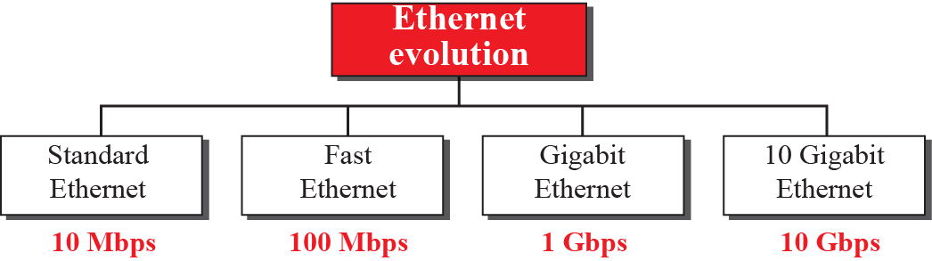
Figure 13.2 : Ethernet evolution
13.9
Notes:
13.#

Slide 10
13-2 STANDARD ETHERNET
We refer to the original Ethernet technology with the data rate of 10 Mbps as the Standard Ethernet. Although most implementations have moved to other technologies in the Ethernet evolution, there are some features of the Standard Ethernet that have not changed during the evolution. We discuss this standard version first.
13.10
Notes:
13.#

Slide 11
13.2.1 Characteristics
Let us first discuss some characteristics of the Standard Ethernet.
13.11
Notes:
13.#

Slide 12
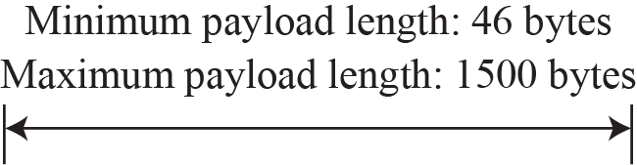
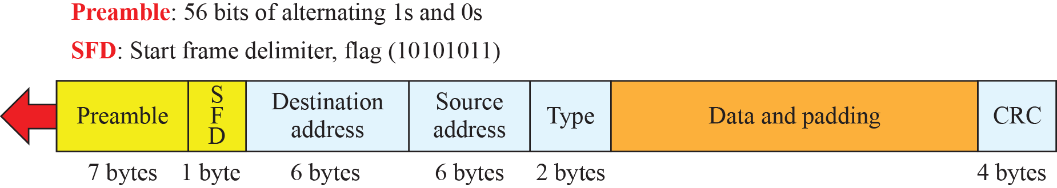
Figure 13.3: Ethernet frame
13.12
Notes:
13.#

Slide 13
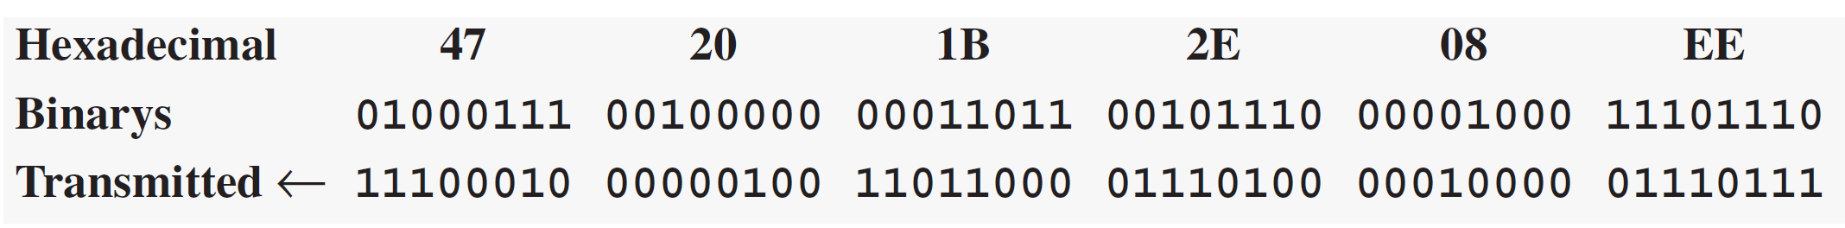
Example 13.1
Show how the address 47:20:1B:2E:08:EE is sent out online.
Solution
The address is sent left to right, byte by byte; for each byte, it is sent right to left, bit by bit, as shown below:
4=0100
7=0111
So 47= 01000111
Transmitted = reverse of Binarys
13.13
Notes:
13

Slide 14
13.2.2 Addressing
Each station on an Ethernet network (such as a PC, workstation, or printer) has its own network interface card (NIC). The NIC fits inside the station and provides the station with a link-layer address. The Ethernet address is 6 bytes (48 bits), normally written in hexadecimal notation, with a colon between the bytes. For example, the following shows an Ethernet MAC address:
13.14
Notes:
13.#

Slide 15

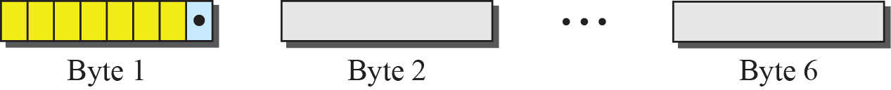
Figure 13.4: Unicast and multicast addresses
13.15
Notes:
13.#

Slide 16
Example 13.2
Define the type of the following destination addresses:
4A:30:10:21:10:1A
47:20:1B:2E:08:EE
FF:FF:FF:FF:FF:FF
Solution
To find the type of the address, we need to look at the second hexadecimal digit from the left. If it is even, the address is unicast. If it is odd, the address is multicast. If all digits are Fs, the address is broadcast. Therefore, we have the following:
13.16
Notes:
16

Slide 17
Example 13.2 (continued)
a. This is a unicast address because A in binary is 1010 (even).
b. This is a multicast address because 7 in binary is 0111 (odd).
c. This is a broadcast address because all digits are Fs in
hexadecimal.
13.17
Notes:
17

Slide 18
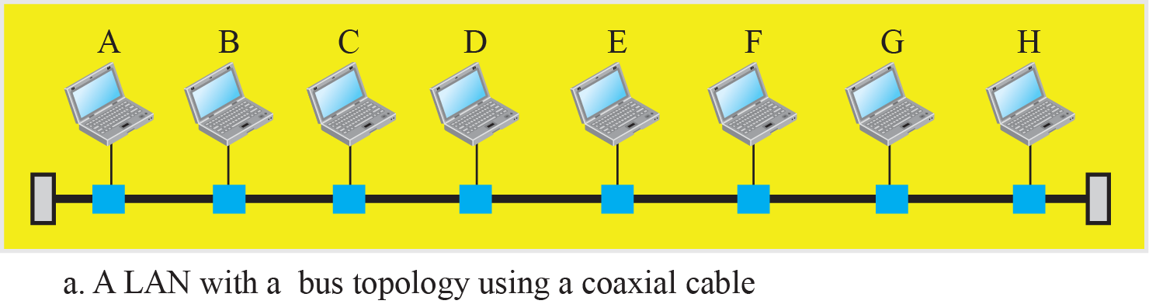
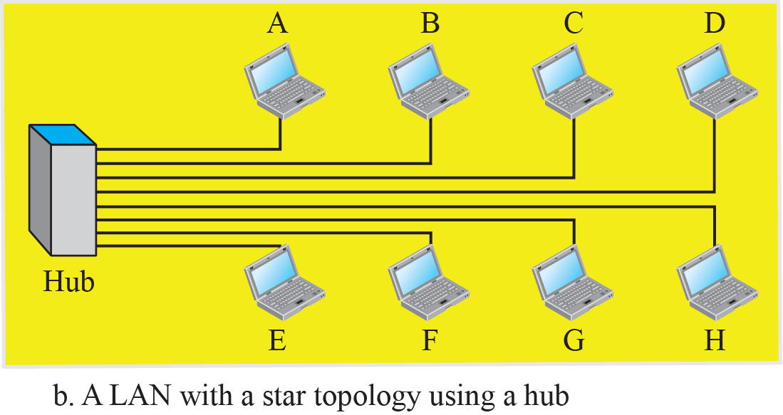
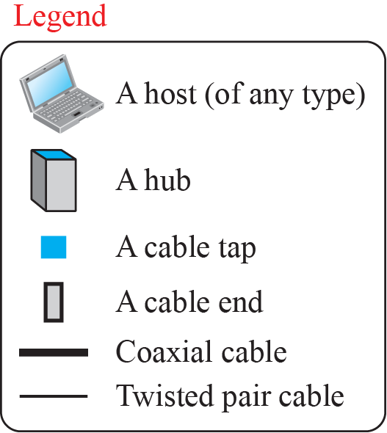
Figure 13.5: Implementation of standard Ethernet
13.18
Notes:
13.#

Slide 19
13.2.3 Access Method
Since the network that uses the standard Ethernet protocol is a broadcast network, we need to use an access method to control access to the sharing medium. The standard Ethernet chose CSMA/CD with 1-persistent method, discussed earlier in Chapter 12, Section 13.3. Let us use a scenario to see how this method works for the Ethernet protocol.
13.19
Notes:
13.#

Slide 20
13.2.4 Efficiency of Standard Ethernet
The efficiency of the Ethernet is defined as the ratio of the time used by a station to send data to the time the medium is occupied by this station. The practical efficiency of standard Ethernet has been measured to be
Efficiency=Propogation Delay
Transmission Delay
13.20
Notes:
13.#

Slide 21
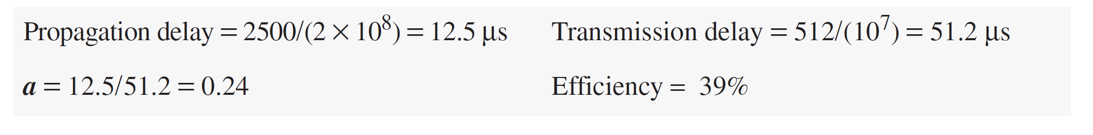
Example 13.3
In the Standard Ethernet with the transmission rate of 10 Mbps, we assume that the length of the medium is 2500 m and the size of the frame is 512 bits. The propagation speed of a signal in a cable is normally 2 × 10⁸ m/s.
The example shows that a = 0.24, which means only 0.24 of a frame occupies the whole medium in this case. The efficiency is 39 percent, which is considered moderate; it means that only 61 percent of the time the medium is occupied but not used by a station.
13.21
Notes:
21

Slide 22
13.2.5 Implementation
The Standard Ethernet defined several implementations, but only four of them became popular during the 1980s. Table 13.1 shows a summary of Standard Ethernet implementations.
13.22
Notes:
13.#

Slide 23
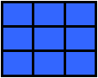
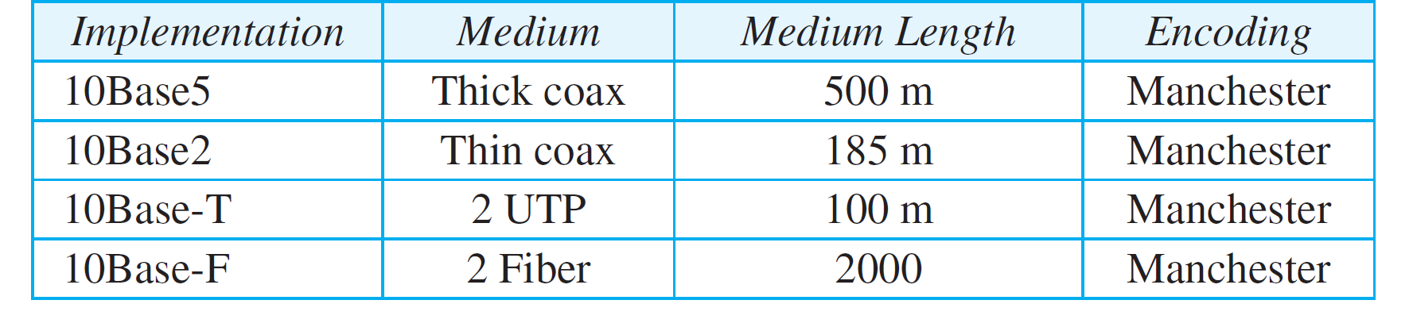
Table 13.1: Summary of Standard Ethernet implementations
10MBPS,Baseband,distance
13.23
Notes:
23

Slide 24
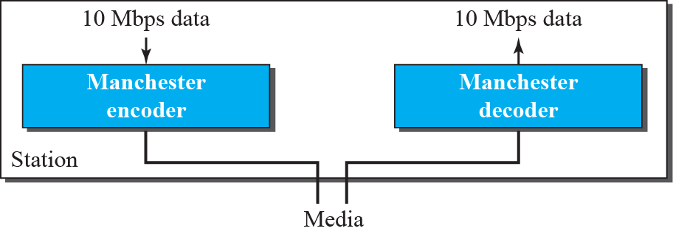
Figure 13.6: Encoding in a Standard Ethernet
13.24
Notes:
13.#

Slide 25
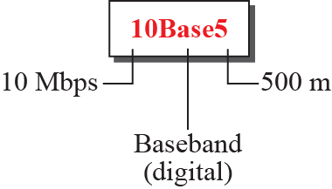
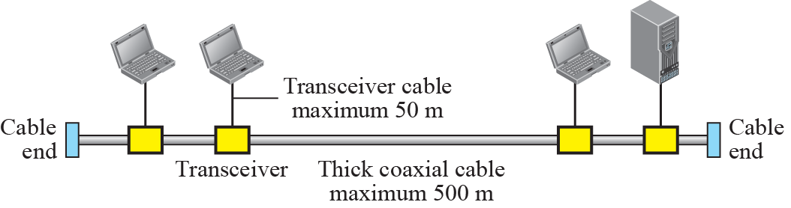
Figure 13.7: 10Base5 implementation
13.25
Notes:
13.#

Slide 26
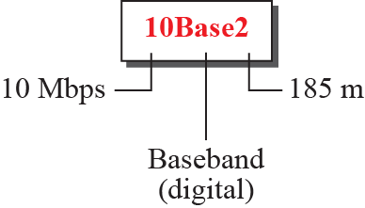
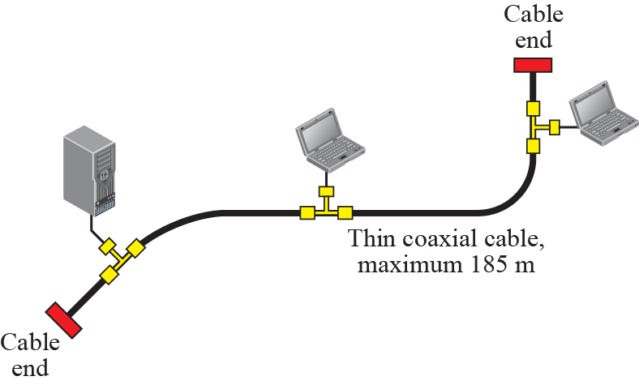
Figure 13.8: 10Base2 implementation
13.26
Notes:
13.#

Slide 27
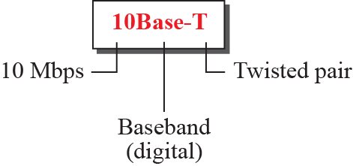
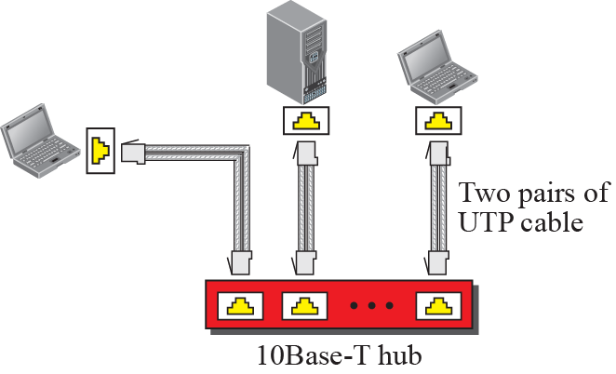
Figure 13.9: 10Base-T implementation
13.27
Notes:
13.#

Slide 28
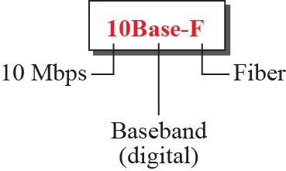
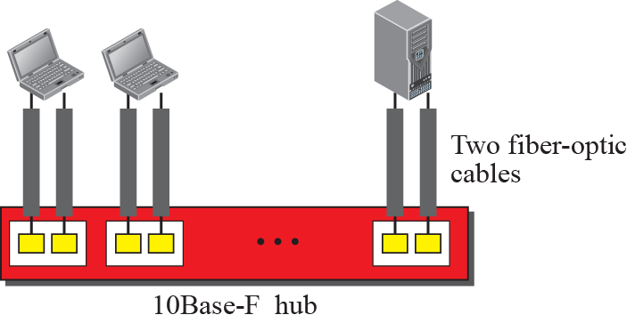
Figure 13.10: 10Base-F implementation
13.28
Notes:
13.#

Slide 29
13.2.6 Changes in the Standard
Before we discuss higher-rate Ethernet protocols, we need to discuss the changes that occurred to the 10-Mbps Standard Ethernet. These changes actually opened the road to the evolution of the Ethernet to become compatible with other high-data-rate LANs.
13.29
Notes:
13.#

Slide 30
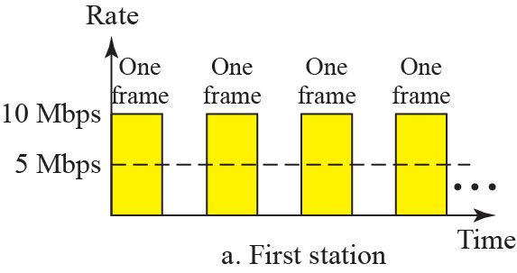
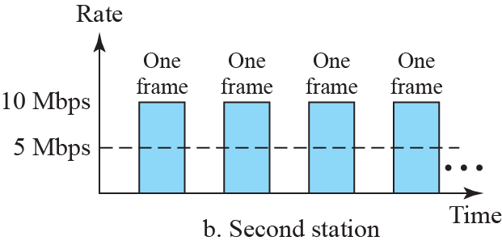
Figure 13.11: Sharing bandwidth
13.30
Notes:
13.#

Slide 31
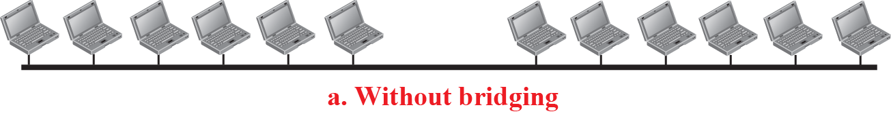
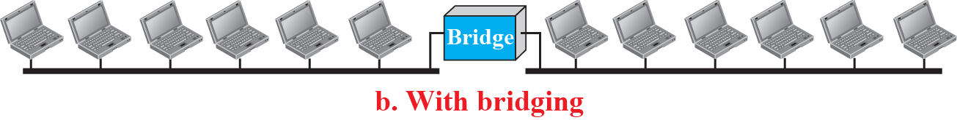
Figure 13.12: A network with and without bridging
13.31
Notes:
13.#

Slide 32
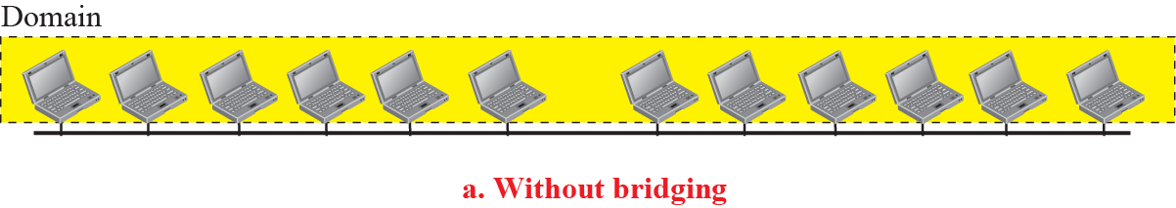
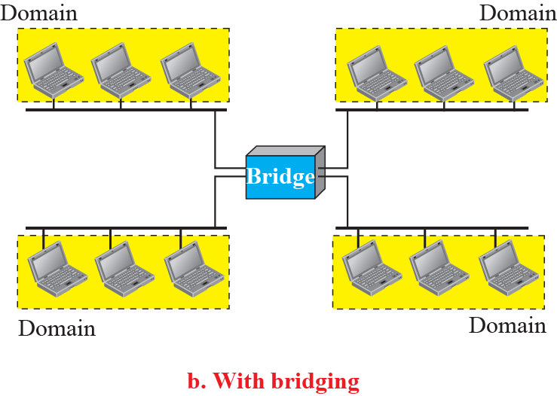
Figure 13.13: Collision domains
When first device send data and simultaneously end device send data its Collison on network
Here we reduce collision
13.32
Notes:
13.#

Slide 33
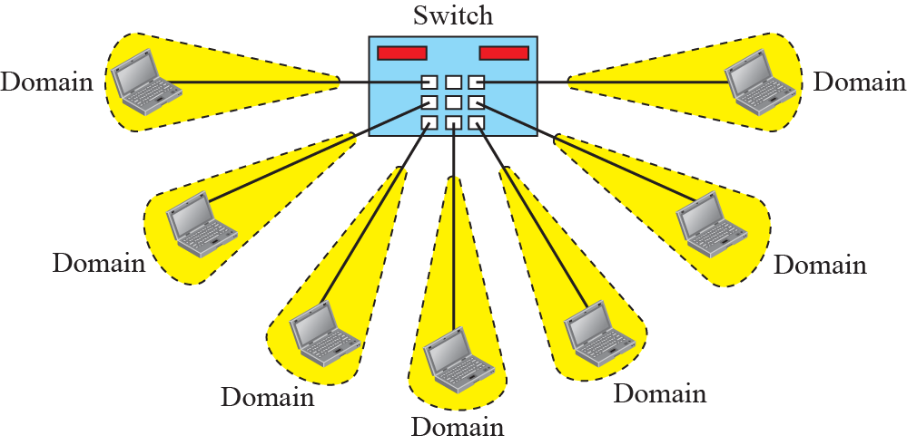
Figure 13.14: Switched Ethernet
13.33
Notes:
13.#

Slide 34
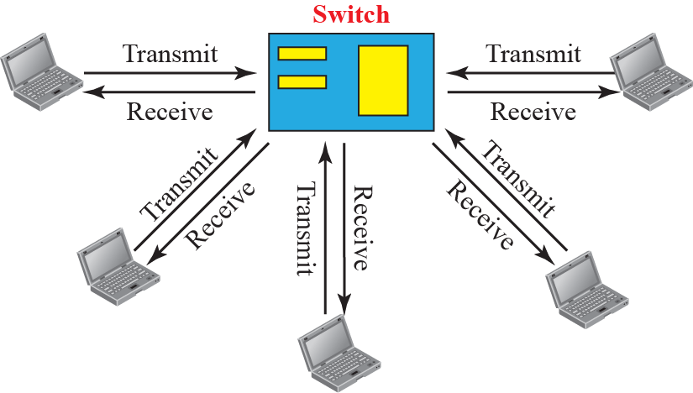
Figure 13.15: Full – duplex switched Ethernet
13.34
Notes:
13.#

Slide 35
13-3 FAST ETHERNET
In the 1990s, Ethernet made a big jump by increasing the transmission rate to 100 Mbps, and the new generation was called the Fast Ethernet. The designers of the Fast Ethernet needed to make it compatible with the Standard Ethernet. The MAC sublayer was left unchanged. But the features of the Standard Ethernet that depend on the transmission rate, had to be changed.
13.35
Notes:
13.#

Slide 36
13.3.1 Access Method
We remember that the proper operation of the CSMA/CD depends on the transmission rate, the minimum size of the frame, and the maximum network length. If we want to keep the minimum size of the frame, the maximum length of the network should be changed. In other words, if the minimum frame size is still 512 bits, and it is transmitted 10 times faster, the collision needs to be detected 10 times sooner, which means the maximum length of the network should be 10 times shorter (the propagation speed does not change).
13.36
Notes:
13.#

Slide 37
13.3.2 Physical Layer
To be able to handle a 100 Mbps data rate, several changes need to be made at the physical layer.
13.37
Notes:
13.#

Slide 38
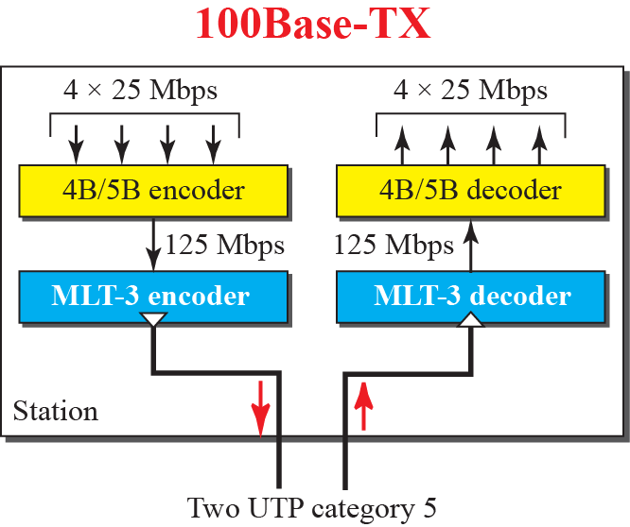
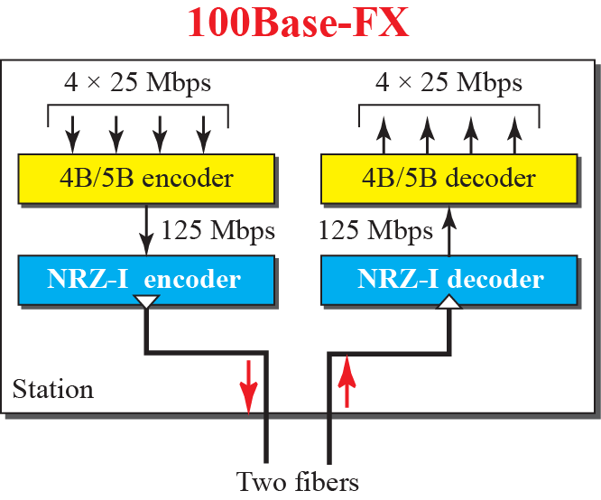
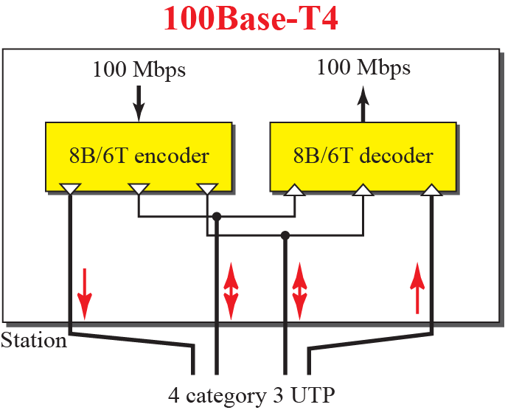
Figure 13.16: Encoding for fast Ethernet
13.38
Notes:
13.#

Slide 39
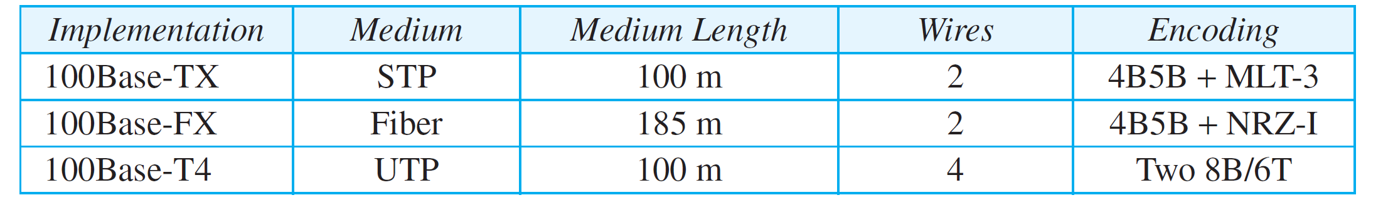
Table 13.2: Summary of Fast Ethernet implementations
13.39
Notes:
39

Slide 40
13-4 GIGABIT ETHERNET
The need for an even higher data rate resulted in the design of the Gigabit Ethernet Protocol (1000 Mbps). The IEEE committee calls it the Standard 802.3z. The goals of the Gigabit Ethernet were to upgrade the data rate to 1 Gbps, but keep the address length, the frame format, and the maximum and minimum frame length the same.
13.40
Notes:
13.#

Slide 41
13.4.1 MAC Sublayer
A main consideration in the evolution of Ethernet was to keep the MAC sublayer untouched. However, to achieve a data rate of 1 Gbps, this was no longer possible. Gigabit Ethernet has two distinctive approaches for medium access: half-duplex and full-duplex. Almost all implementations of Gigabit Ethernet follow the full-duplex approach, so we mostly ignore the half-duplex mode.
13.41
Notes:
13.#

Slide 42
13.4.2 Physical Layer
The physical layer in Gigabit Ethernet is more complicated than that in Standard or Fast Ethernet. We briefly discuss some features of this layer.
13.42
Notes:
13.#

Slide 43
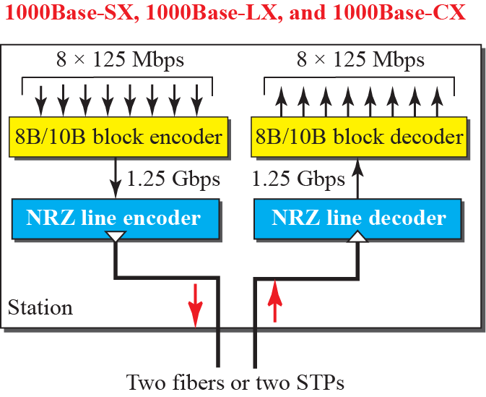
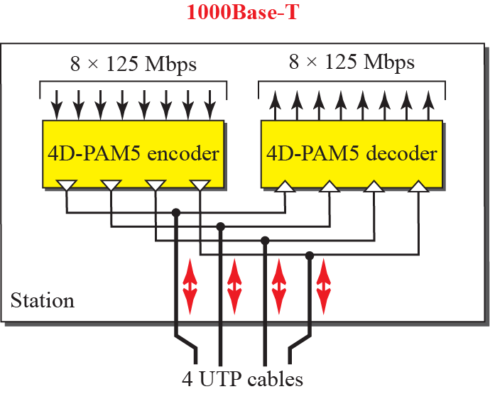
Figure 13.17: Encoding in Gigabit Ethernet
13.43
Notes:
13.#

Slide 44
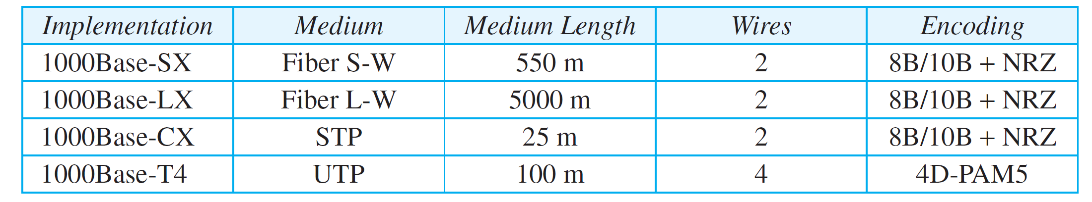
Table 13.3: Summary of Gigabit Ethernet implementations
13.44
Notes:
44

Slide 45
13-5 10-GIGABIT EHTERNET
In recent years, there has been another look into the Ethernet for use in metropolitan areas. The idea is to extend the technology, the data rate, and the coverage distance so that the Ethernet can be used as LAN and MAN (metropolitan area network). The IEEE committee created 10 Gigabit Ethernet and called it Standard 802.3ae.
13.45
Notes:
13.#

Slide 46
13.5.1 Implementation
10 Gigabit Ethernet operates only in full-duplex mode, which means there is no need for contention; CSMA/CD is not used in 10 Gigabit Ethernet. Four implementations are the most common: 10GBase-SR, 10GBase-LR, 10GBase-EW, and 10GBase-X4. Table 13.4 shows a summary of the 10 Gigabit Ethernet implementations. We discussed the encoding in Chapter 4.
13.46
Notes:
13.#

Slide 47
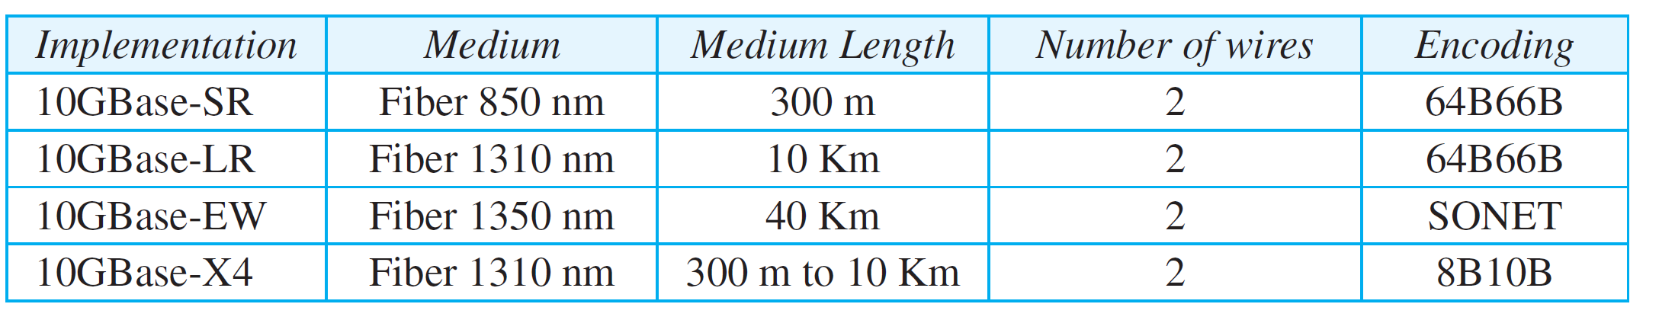
Table 13.4: Summary of 10-Gigabit Ethernet implementations
13.47
Notes:
47

